Slide 1


PEOPLE’S COMMITTEE OF DISTRICT 12
NGUYEN DU PRIMARY SCHOOL
WELCOME TO GRADE 5
Presented by Ms.Ñieåu

Slide 2


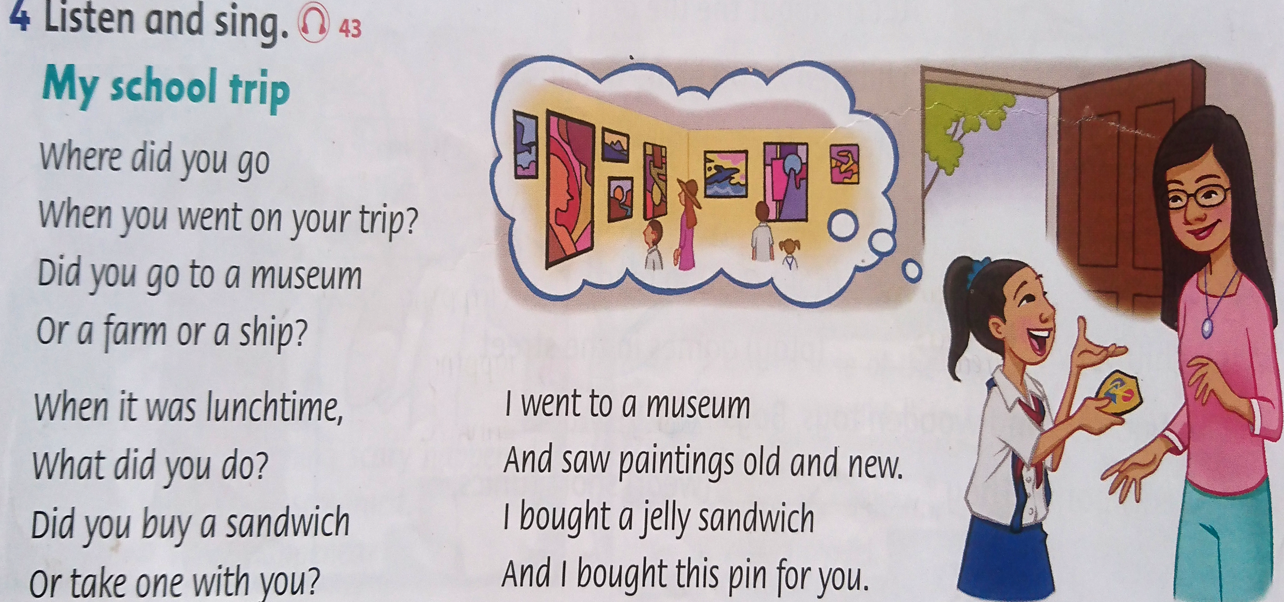


Slide 3

Unit 8: Lesson 1
CONTENT
VOCABULARY
EXERCISES

Slide 4
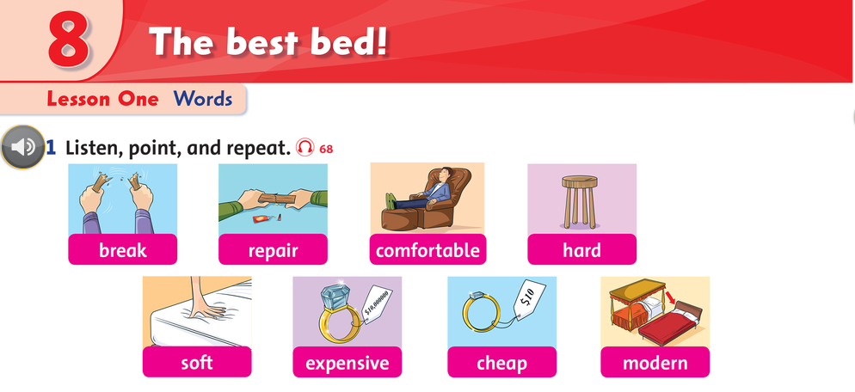

Slide 5


















bẻ gãy
sửa chữa
thoải mái
cứng
mềm
đắt tiền
rẻ tiền
hiện đại

Slide 6


Slide 7
LUCKY NUMBERS
1
2
3
4
5
6
7
8
TEAM A
TEAM B

Slide 8
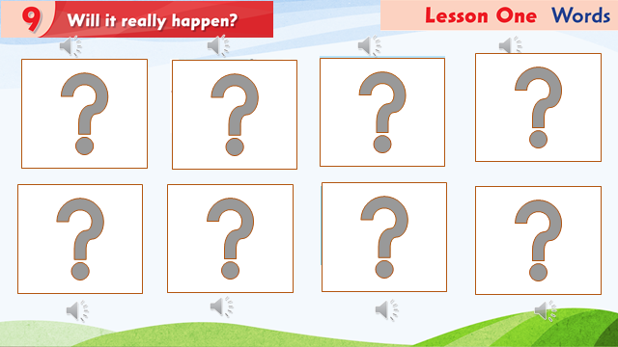

Slide 9

HOMEWORK
Workbook Page 54, 55

